Slide 1

Units 7 & 8:
Culture Corner D
--- Page 93 ---

Slide 2
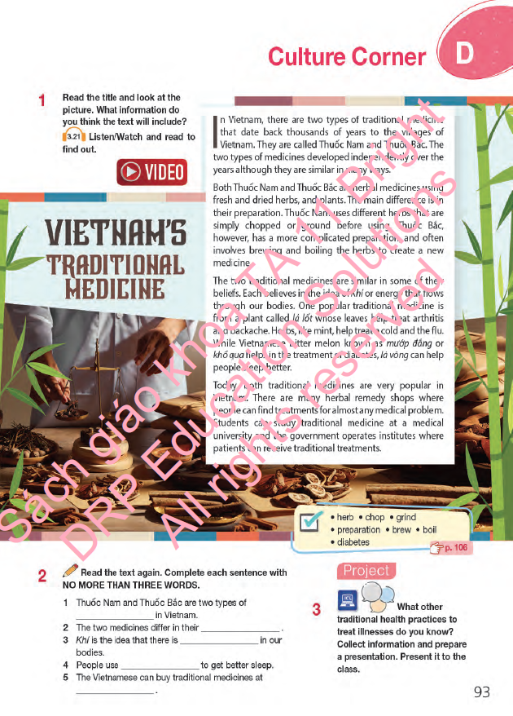
Lesson Outline
Warm-up
Vocabulary
Reading
Project
Consolidation
Wrap-up

Slide 3

By the end of this lesson, students will be able to…
learn about Vietnamese traditional medicine and related vocabulary.
practise reading for main ideas and specific information (sentence completion – IELTS question type).
practise presentation / public speaking – other traditional health practices.

Slide 4

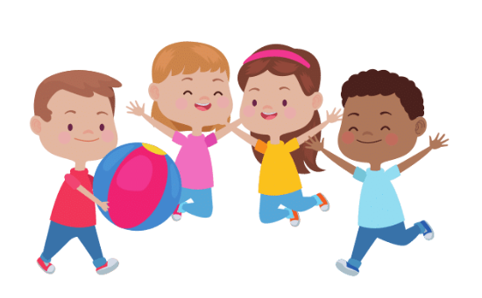

Slide 5
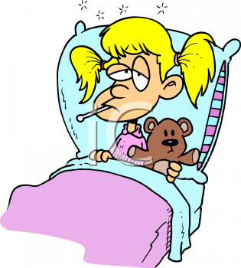
Group Discussion
What do you often do when you get sick?
→ sleep/ take medicine/ go to the hospitals/…
2. Have you ever tried any traditional ways of treatment?
→ acupuncture / traditional medicine/ herbs/…

Slide 6

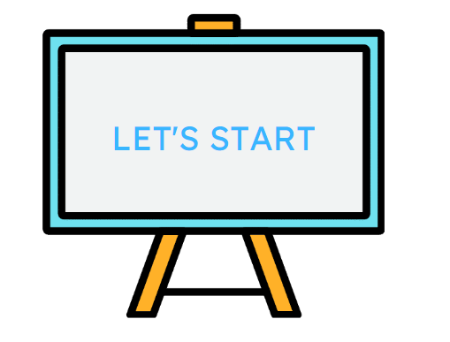

Slide 7

Pre-reading

Slide 8
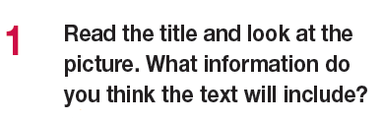
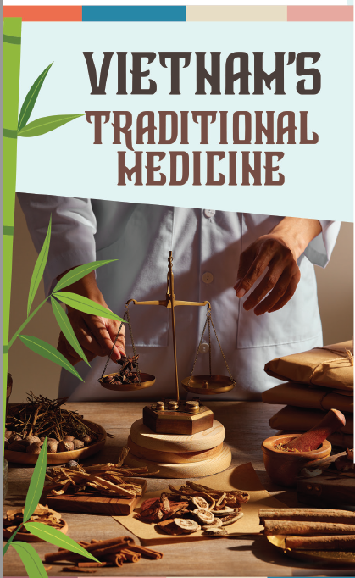
The text includes information about the Vietnam’s traditional medicine Thuốc Nam and Thuốc Bắc and how the Vietnamese use traditional medicine to treat minor illnesses.

Slide 9
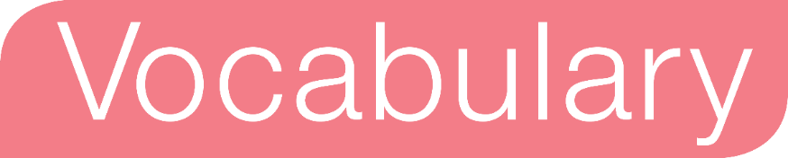
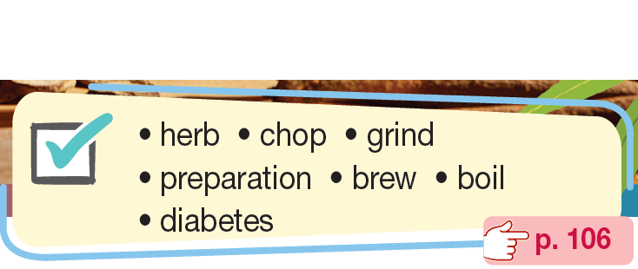
Do you know any of these words?

Slide 10

Read the text, highlight the sentences containing these words and guess their meanings.
In Vietnam, there are two types of traditional medicines that date back thousands of years to the villages of Vietnam. They are called Thuốc Nam and Thuốc Bắc. The two types of medicines developed independently over the years although they are similar in many ways.
Both Thuốc Nam and Thuốc Bắc are herbal medicines using fresh and dried herbs, and plants. The main difference is in their preparation. Thuốc Nam uses different herbs that are simply chopped or ground before using. Thuốc Bắc, however, has a more complicated preparation, and often involves brewing and boiling the herbs to create a new medicine.
The two traditional medicines are similar in some of their beliefs. Each believes in the idea of Khí or energy that flows through our bodies. One popular traditional medicine is from a plant called lá lốt whose leaves help treat arthritis and backache. Herbs, like mint, help treat a cold and the flu. While Vietnamese bitter melon known as mướp đắng or khổ qua helps in the treatment of diabetes, lá vông can help people sleep better.
Today, both traditional medicines are very popular in Vietnam. There are many herbal remedy shops where people can find treatments for almost any medical problem. Students can study traditional medicine at a medical university and the government operates institutes where patients can receive traditional treatments.

Slide 11

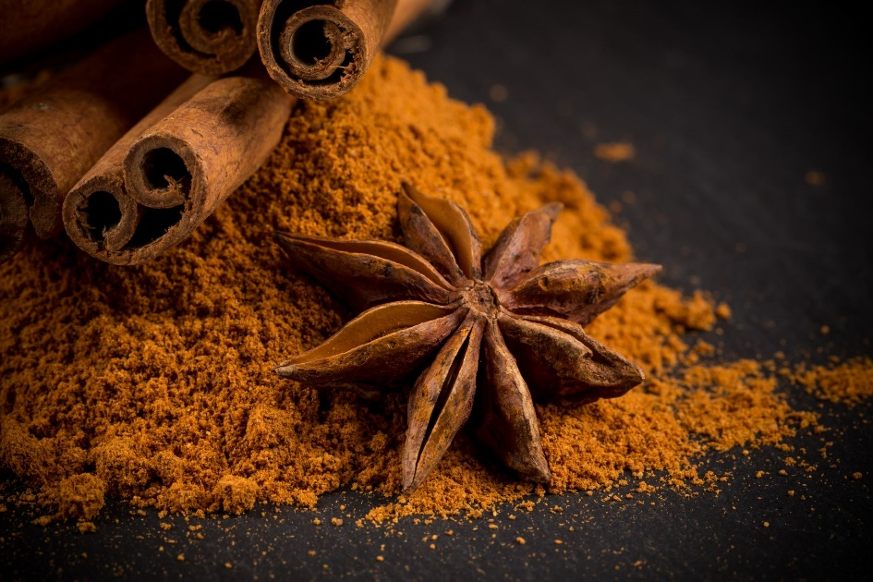
herb /hɜːb/ (n): a type of plant whose leaves are used in cooking to give flavour to particular dishes or in making medicine.
Cây thuốc, thảo dược
Many kinds of herbs and spices are used in South Asian cooking.

Slide 12
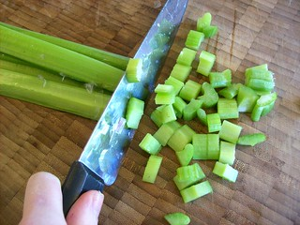
chop /tʃɒp/ (v): to cut something into pieces with an axe, knife or other sharp instrument.
Chặt, băm nhỏ
He was chopping wood in the yard.

Slide 13
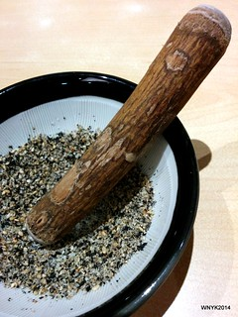
grind /ɡraɪnd/ (v): to make something into small pieces or powder by pressing between hard surfaces.
Nghiền
We need to grind a little black pepper over the salad.

Slide 14

preparation /ˌprepərˈeɪʃən/ (n): a mixture of substances, often for use as a medicine.
(thuốc) điều chế, bào chế
Many kinds of traditional medicine require complicated preparations.

Slide 15
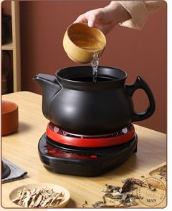
brew /bruː/ (v): to add boiling water to something such as tea or coffee, and then allow it to steep for a particular amount of time.
ngâm, ủ
Freshly brewed coffee is now favorite drink of many young people.

Slide 16
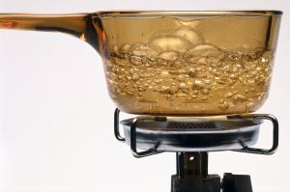
boil /bɔɪl/ (v): to heat a container, especially one used for cooking, until the liquid in it starts to turn into a gas.
đun sôi
We have to boil the soup before adding beef.

Slide 17
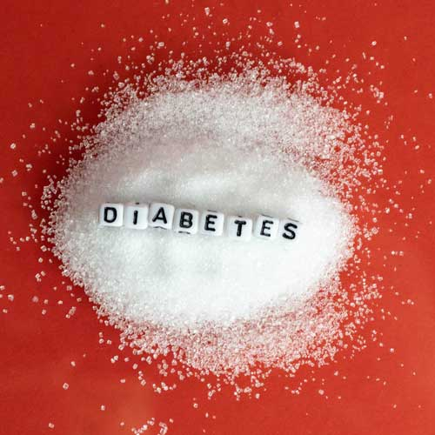
diabetes/ˌdaɪəˈbiːtiːz/ (n): a disease in which the body cannot control the level of sugar in the blood.
bệnh tiểu đường
Diabetes has been affected millions of people in the world.

Slide 18
Listen and repeat.
herb /hɜːb/ (n): cây thuốc, thảo dược
chop /tʃɒp/ (v): chặt băm nhỏ.
grind /ɡraɪnd/ (v): nghiền
preparation /ˌprepərˈeɪʃən/ (n): (thuốc) điều chế, bào chế
brew /bruː/ (v): ngâm, ủ
boil /bɔɪl/ (v): đun sôi
diabetes /ˌdaɪəˈbiːtiːz/ (n): bệnh tiểu đường
Notes:
Click the words to hear the audio.

Slide 19

While - reading

Slide 20

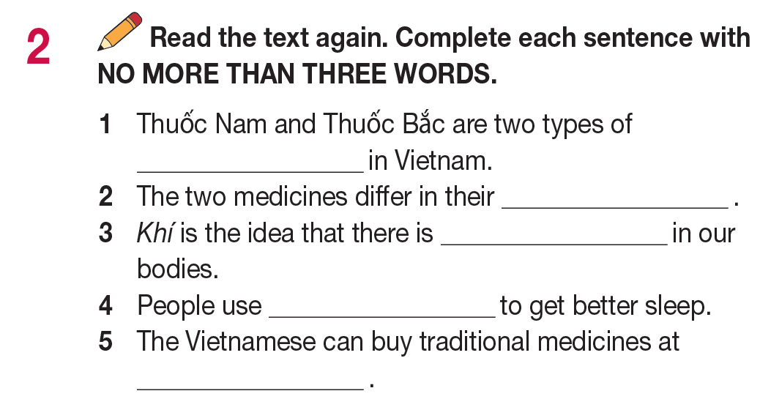
Identify the key words

Slide 21


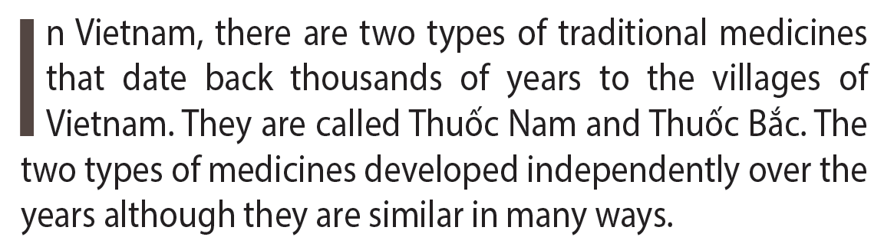
Let’s check your answers.
traditional medicine

Slide 22
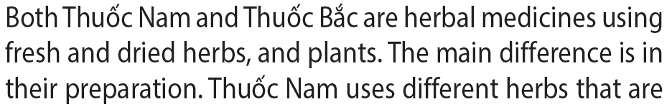
Let’s check your answers.
preparation

Slide 23

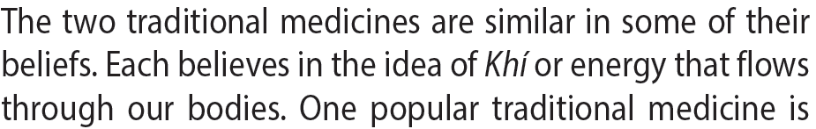
Let’s check your answers.
energy

Slide 24
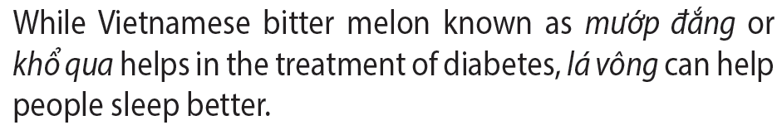
Let’s check your answers.
lá vông

Slide 25

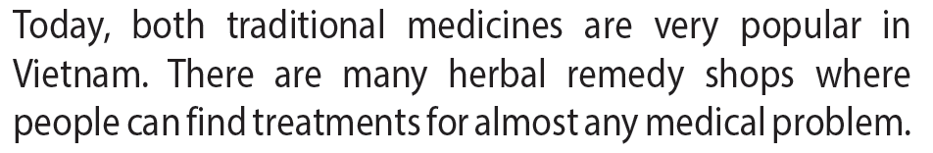
Let’s check your answers.
herbal remedy shop

Slide 26
Extra Practice - Read the text again answer the following questions.
When did Thuốc Nam and Thuốc Bắc created?
What are they made from?
What needs to be done with the herbs before using Thuốc Nam?
What are the uses of lá lốt?
Where can students study traditional medicine?

Slide 27
Let’s check your answers.
thousands of years ago

Slide 28
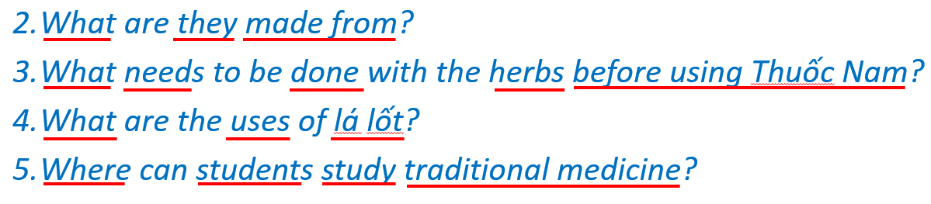
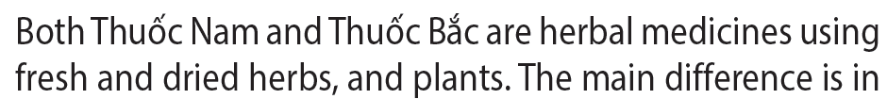
Let’s check your answers.
Fresh and dried herbs and plants

Slide 29
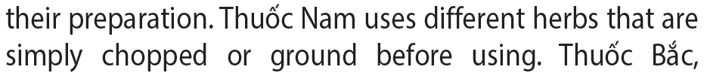
Let’s check your answers.
They are simply chopped and ground

Slide 30
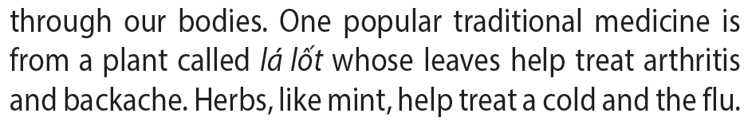
Let’s check your answers.
Help treat arthritis and backache

Slide 31
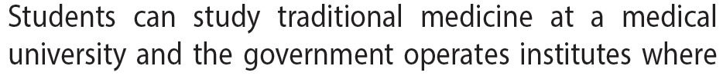
Let’s check your answers.
medical university

Slide 32
Project

Slide 33
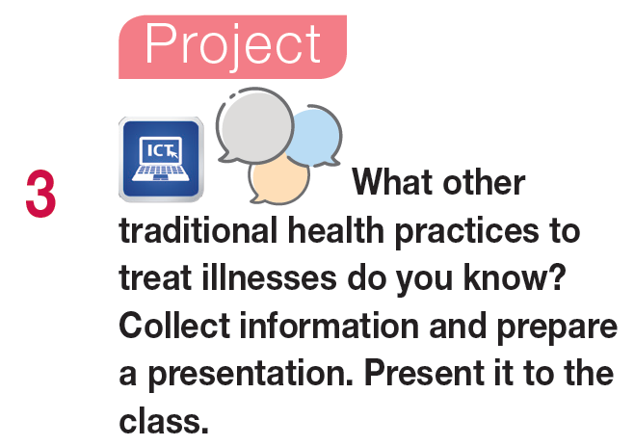

Slide 34
Project
Acupuncture
Sample answer
Acupuncture is a traditional Chinese practice used to treat headaches, back pain, asthma, arthritis and other muscle and body pain. The practitioners use small metal needles and insert them into various different parts of the body through the skin. The needles are very thin and do not cause much, if any, pain when they are inserted. The needles do not go very far into the skin. Different areas are believed to trigger specific parts of the nervous system.
For example, there are certain areas which are thought to control addictive behaviour to substances like alcohol or tobacco. Therefore, patients often go to see an acupuncturist to get help to break these habits. Other people seek acupuncture for general well-being as well as for a wide variety of other illnesses that are not serious. Acupuncture can stimulate the body’s healing abilities and make the patients feel better physically and mentally.

Slide 35




Slide 36

Write a short paragraph (about 80-100 words) about an traditional treatment you have experienced or heard about.

Slide 37
Project
Sample answer
Acupressure therapy originated in India. After the spread of Buddhism, this kind of therapy was integrated into common medical practice in China and became known as acupuncture. Acupressure is a kind of massage which is based on the traditional Chinese medicine practice of acupuncture. In treatment, physical pressure is applied to specific points on the human body, which are called acupoints. The aim of acupressure is to help the muscles relax and improve blood flow. It can also be effective in reducing pain and headaches. Acupressure can be done using hands, elbows or other devices.

Slide 38

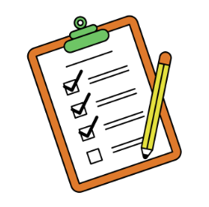

Slide 39
Today’s lesson
Vocabulary: Vietnamese traditional medicine
Reading: for general and specific information
Speaking: other traditional health practices.

Slide 40

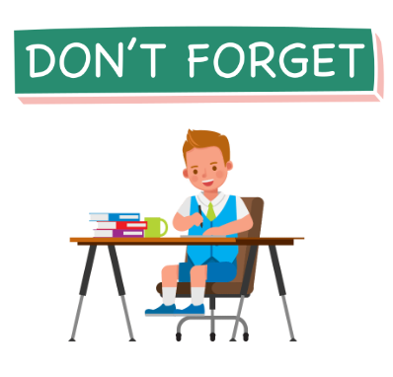
Review the learnt vocabulary in today’s lesson
Do the exercises in WB: page 68
Prepare: CLIL D – Science (page 94 – SB).

Slide 41
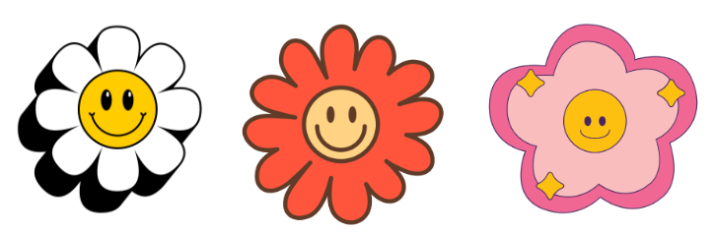
Stay positive and have a happy day!
See you in the next lesson.

