Slide 1

Units 5 & 6:
CLIL C - PSHE
--- Page 74 ---

Slide 2
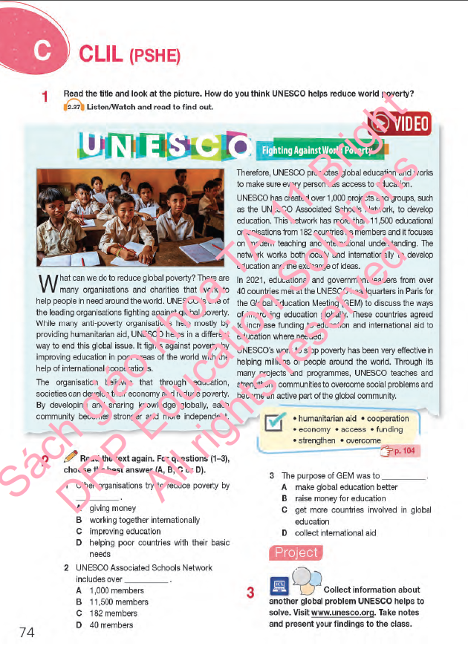
Lesson Outline
Warm-up
Vocabulary
Reading
Project
Consolidation
Wrap-up

Slide 3

By the end of this lesson, students will be able to…
learn the way that UNESCO solves global problems and related vocabulary.
practise reading for main ideas and specific information (multiple choice).
practise presentation – another global problem that UNESCO helps to solve.

Slide 4



Slide 5

Group Discussion
What organization is it?
UNESCO - United Nations Educational,
Scientific and Cultural Organization
2. What are their main responsibilities?
→ UNESCO's mission is to contribute to the building of a culture of peace, the eradication of poverty, sustainable development and intercultural dialogue through education, the sciences, culture, communication, and information.

Slide 6



Slide 7

Pre-reading

Slide 8
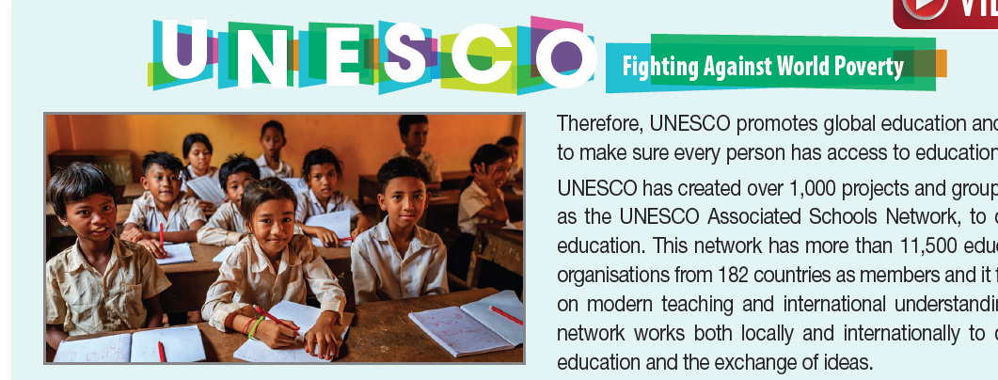
Exercise 1 SB, p.74
UNESCO helps to reduce poverty by improving education around the world and by cooperating with educational and government leaders who are willing to increase funding for the achievement of this goal.

Slide 9

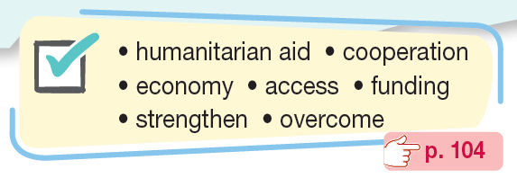
Do you know any of these words?

Slide 10

Read the text, highlight the sentences containing these words and guess their meanings.
What can we do to reduce global poverty? There are many organisations and charities that work to help people in need around the world. UNESCO is one of the leading organisations fighting against global poverty. While many anti-poverty organisations help mostly by providing humanitarian aid, UNESCO helps in a different way to end this global issue. It fights against poverty by improving education in poor areas of the world with the help of international cooperations.
The organisation believes that through education, societies can develop their economy and reduce poverty. By developing and sharing knowledge globally, each community becomes stronger and more independent. Therefore, UNESCO promotes global education and works to make sure every person has access to education.
UNESCO has created over 1,000 projects and groups, such as the UNESCO Associated Schools Network, to develop education. This network has more than 11,500 educational organisations from 182 countries as members and it focuses on modern teaching and international understanding. The network works both locally and internationally to develop education and the exchange of ideas.
In 2021, educational and government leaders from over 40 countries met at the UNESCO headquarters in Paris for the Global Education Meeting (GEM) to discuss the ways of improving education globally. These countries agreed to increase funding to education and international aid to education where needed.
UNESCO’s work to stop poverty has been very effective in helping millions of people around the world. Through its many projects and programmes, UNESCO teaches and strengthens communities to overcome social problems and become an active part of the global community.

Slide 11

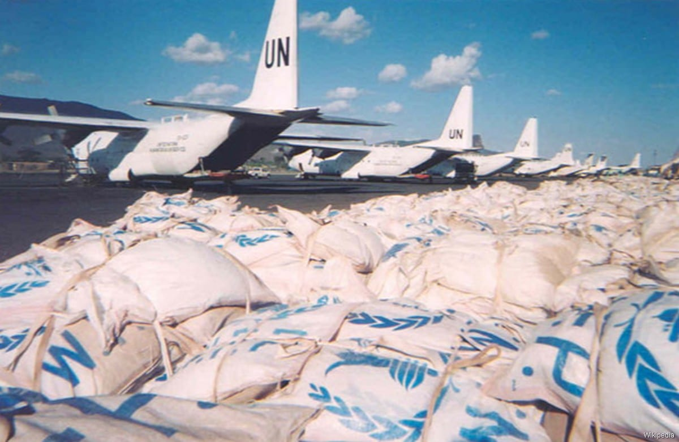
humanitarian aid /hjuːˌmænɪˈteəriən eɪd/(phr): help or support to improve people’s lives and reduce suffering.
Viện trợ nhân đạo
The United Nations is sending humanitarian aid (food and supplies) to the areas affected by the wars.

Slide 12

cooperation /kəʊˌɒpərˈeɪʃən/ (n): the process of working with another company, organization, or country to achieve something.
sự hợp tác
Cooperation between different people is always a key factor in successful marketing campaigns.

Slide 13

economy /iˈkɒnəmi/ (v): the system of trade and industry by which the wealth of a country is made and used.
nền kinh tế
Tourism contributes millions of dollars to the local economy.

Slide 14

access /ˈækses/ (n): the method or possibility of getting near to a place or person.
sự tiếp cận
The government needs to make sure that anyone can have access to education.

Slide 15

funding /ˈfʌndɪŋ/ (n): money given by a government or organization for an event or activity.
sự tài trợ, tiền tài trợ
The students had to get funding for their project on their own.

Slide 16

strengthen /ˈstreŋθən/ (v): to make something stronger or more effective.
làm cho vững mạnh
The organization’s aim is to strengthen the cultural connection among countries.

Slide 17

overcome /ˌəʊvəˈkʌm/ (v): to defeat or succeed in controlling or dealing with something.
vượt qua
Finally, Annie could overcome her shyness in class to stand up and said what she was thinking.

Slide 18
Listen and repeat.
humanitarian aid /hjuːˌmænɪˈteəriən eɪd/(phr): viện trợ nhân đạo
cooperation /kəʊˌɒpərˈeɪʃən/ (n): sự hợp tác
economy /iˈkɒnəmi/ (v): nền kinh tế
access /ˈækses/ (n): sự tiếp cận
funding /ˈfʌndɪŋ/ (n): tiền tài trợ
strengthen /ˈstreŋθən/ (v): làm cho vững mạnh
overcome /ˌəʊvəˈkʌm/ (v): vượt qua

Slide 19

While - reading

Slide 20

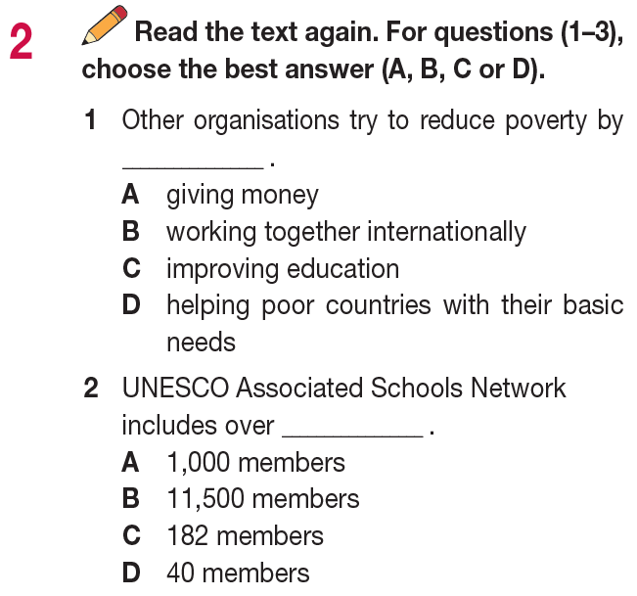
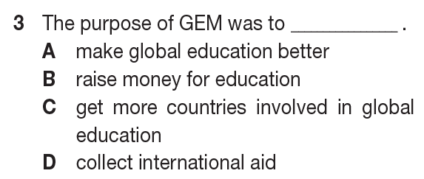
Read the passage the complete this exercise.
Identify the key words

Slide 21
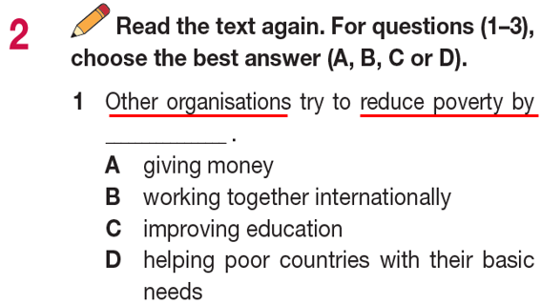
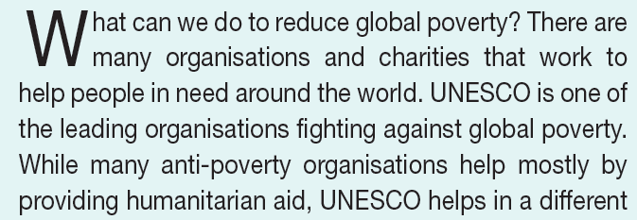
Let’s check your answers.

Slide 22
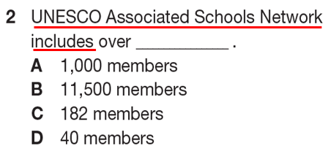
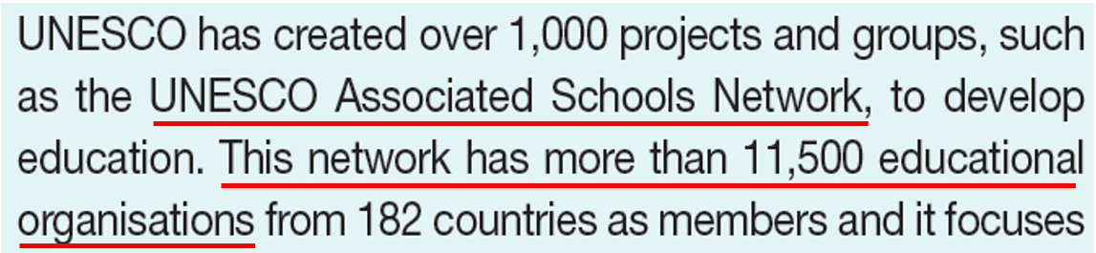
Let’s check your answers.

Slide 23
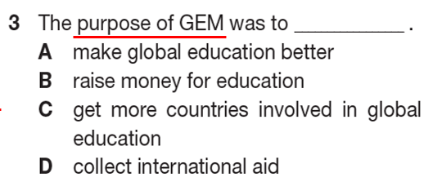
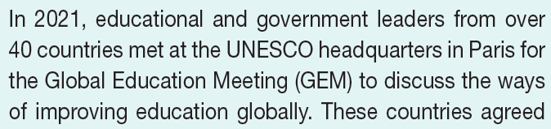
Let’s check your answers.

Slide 24
Read the text again and complete the following sentences
UNESCO helps to solve world poverty by _______ with the help with global cooperations.
With knowledge being shared worldwide, each nation can become stronger and _______.
UNESCO has had around _____ projects and groups to promote education.
UNESCO Associated Schools Network concentrates on _____ and global understanding.
Thanks to their effective solutions, UNESCO ________­­­_ so that they can deal with social problems as well as become more active.

Slide 25
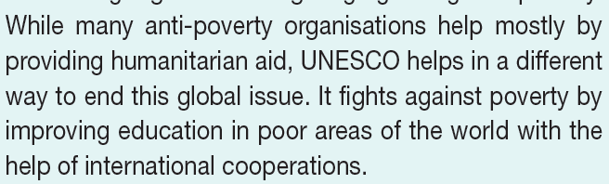
Let’s check your answers.
improving education
UNESCO helps to solve world poverty by ________________ with the help with global cooperations.

Slide 26
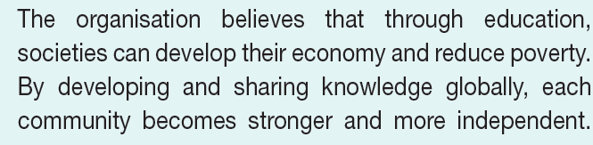
Let’s check your answers.
2. With knowledge being shared worldwide, each nation can become stronger and _______________.
more independent

Slide 27
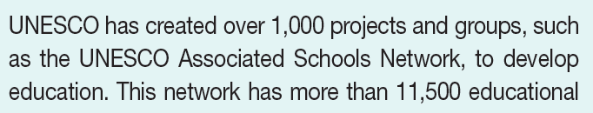
Let’s check your answers.
1,000
3. UNESCO has had around ____________ projects and groups to promote education.

Slide 28
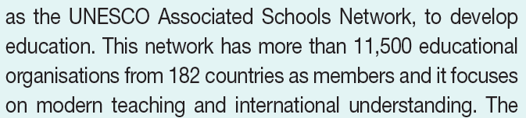
Let’s check your answers.
4. UNESCO Associated Schools Network concentrates on _______________ and global understanding.
modern teaching

Slide 29
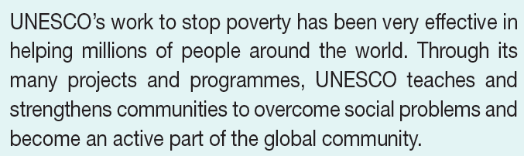
Let’s check your answers.
strengthen communities
5. Thanks to their effective solutions, UNESCO __________________
so that they can deal with social problems as well as become more active.

Slide 30
Unit 3
Post - reading

Slide 31
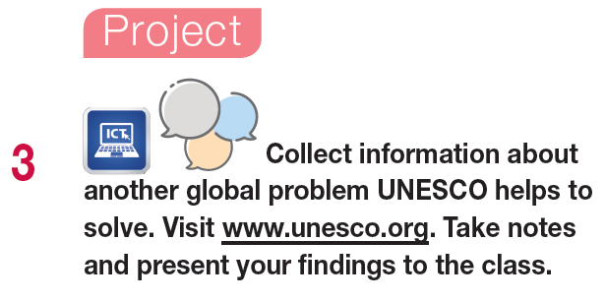
Work in groups.

Slide 32
Sample answer
Apart from education and poverty reduction, UNESCO does a variety of activities connected with the protection of the environment. It helps make the world greener through knowledge of science. People can participate in scientific programmes and help protect animals, plants and natural spaces around the world. UNESCO also has research programmes to measure the quality of water and improve it, so people can have access to safe drinking water around the world. UNESCO works hard to make the world a better place for people and animals by protecting wildlife and the natural environment.

Slide 33




Slide 34

Write a short paragraph (about 90 - 120 words) about one thing that UNESCO has done to help Vietnam.

Slide 35
Project
Sample answer
There are many things that the UNESCO has been doing to support Vietnam. One of them is to help Vietnam protect and conserve Vietnam’s cultural heritage.
Vietnam has more than 40 heritages which were recognised by UNESCO such as the Complex of Hue Monuments, Ha Long Bay, or Trang An Landscape Complex. Over the years, the Vietnam National UNESCO Committee has cooperated with local authorities to protect these heritage sites.
For example, in the 1980s, UNESCO helped Vietnam protect the former imperial city of Hue by organising a global campaign to introduce and promote the beauty of Hue and Vietnam worldwide through films and posters.

Slide 36



Slide 37
Today’s lesson
Vocabulary: the way that UNESCO solves poverty
Reading: for general and specific information
Speaking: another global problem that UNESCO helps to solve.

Slide 38


Review vocabulary of today’s lesson
Do the exercises in WB: 53
Prepare: Progress Check C (page 75 – SB).

Slide 39

Stay positive and have a happy day!
See you in the next lesson.

