Slide 1

Unit 7: HEALTHY LIFESTYLE
Lesson 7e – Writing
--- Page 84 ---

Slide 2
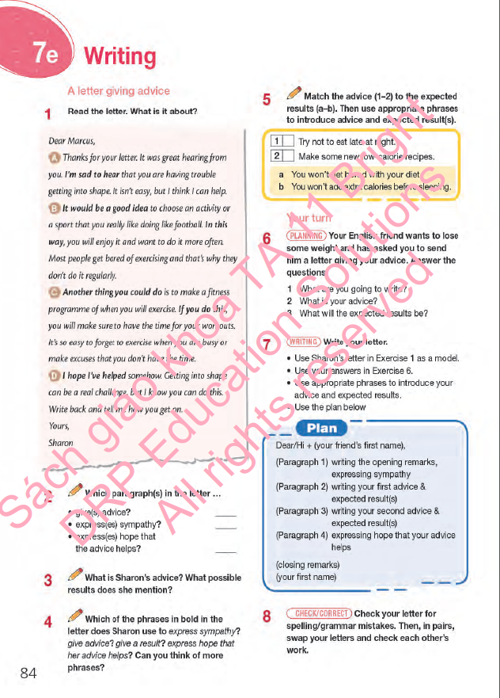
Lesson Outline
Warm-up
Reading
Writing
Consolidation
Wrap-up

Slide 3
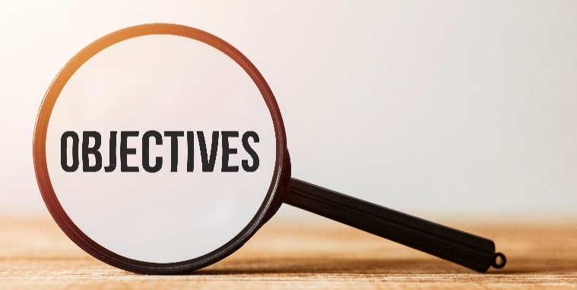
By the end of this lesson, students will be able to…
read for general and specific information.
match advice with expected results.
write a letter giving advice.

Slide 4



Slide 5
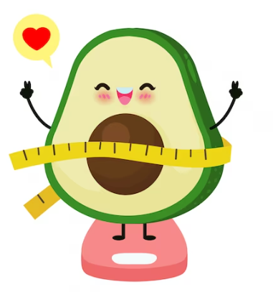
The longest list
Work in groups. Discuss with your partner and write down as many activities about keeping fit and staying healthy as you can.

Slide 6

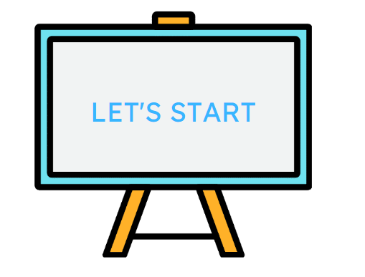

Slide 7

Pre- Writing

Slide 8
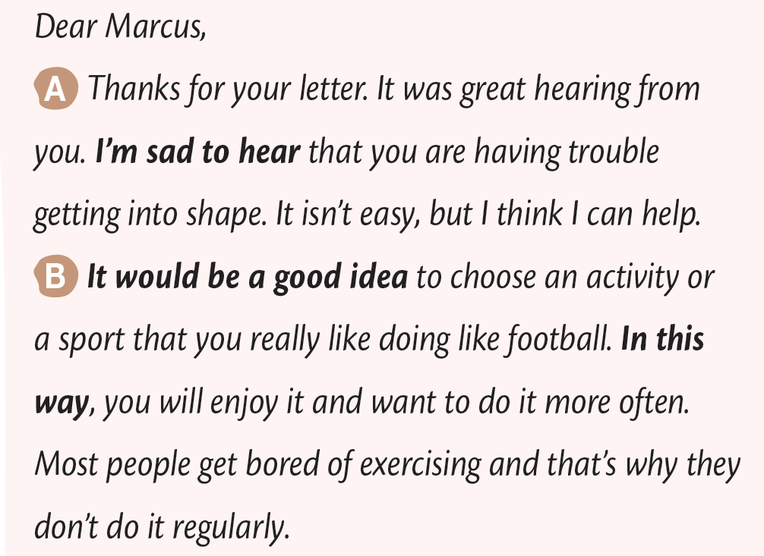
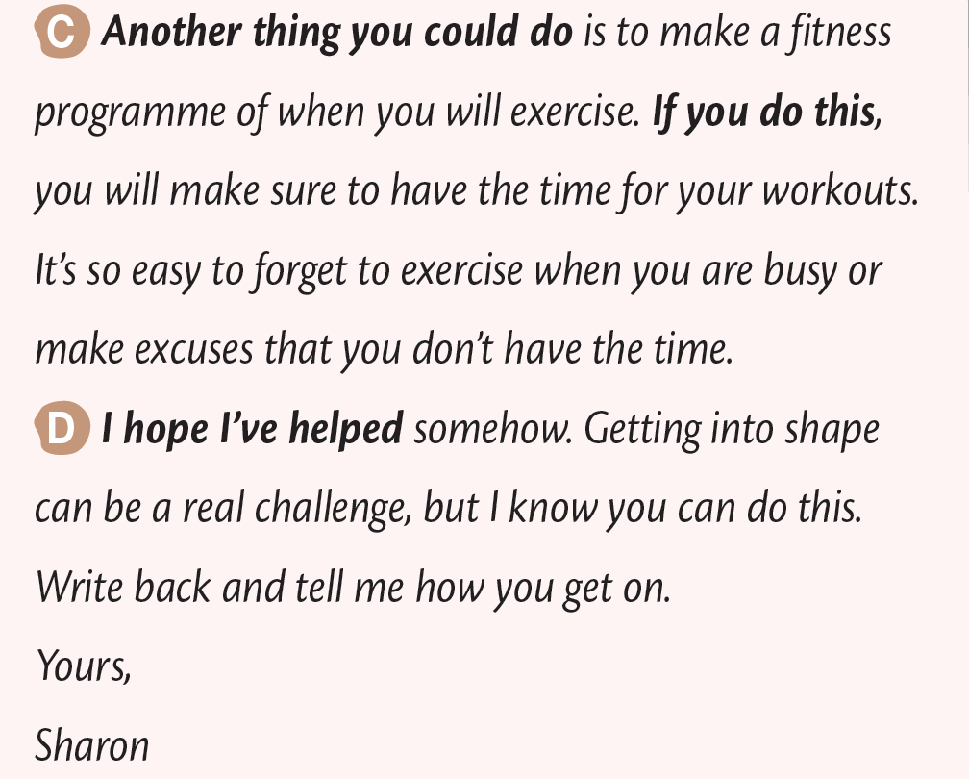
1. Read the letter. What is it about?
The letter is about giving a friend advice on how to get in shape.

Slide 9
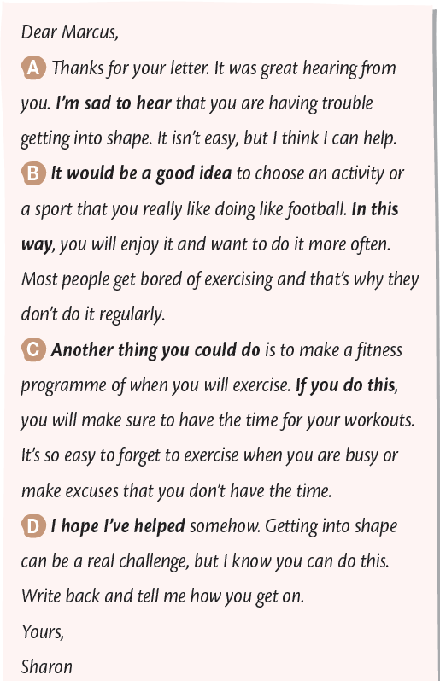
2. Which paragraph(s) in the letter …
• give(s) advice? _____
• express(es) sympathy? _____
• express(es) hope that _____
the advice helps?
B, C
A
D

Slide 10
3. What is Sharon’s advice?
What possible results does she mention?
Sharon’s advice is that Lucas should ...
• choose an activity or sport he really likes doing, like football. In this way, he will enjoy it and want to do it more often.
• make a fitness programme to track his physical activity. If he does this, he will make sure to have the time for his workouts.

Slide 11
4. Which of the phrases in bold in the letter does Sharon use to express sympathy? give advice? give a result? express hope that her advice helps? Can you think of more phrases?

Slide 12
1 Which of the phrases in bold in the letter does Sharon use to express sympathy?
2 Which of the phrases in bold in the letter does Sharon use to give advice?
3 Which of the phrases in bold in the letter does Sharon use to give a result?
4 Which of the phrases in bold in the letter does Sharon use to express hope that her advice helps?
I’m sad to hear …
It would be a good idea …
Another thing you could do…
In this way …
If you do this …
I hope I’ve helped

Slide 13
Write some more similar phrases.
express sympathy | give advice | give a result | express hope that her advice helps
I am so sorry to hear | Why don’t you ... ? | - Therefore - As a result | I hope everything will be alright

Slide 14
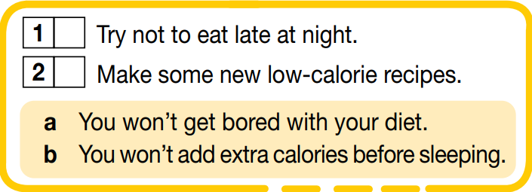
Match the advice (1–2) to the expected results (a–b).
b
a

Slide 15
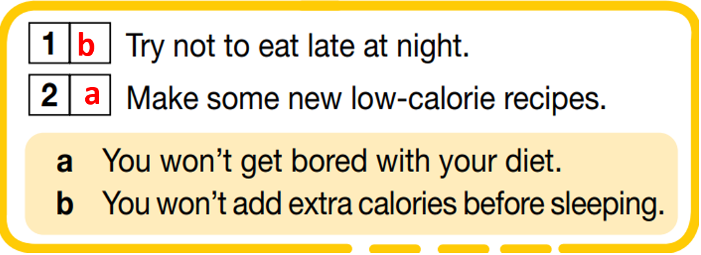
5 Use appropriate phrases to introduce advice and expected results.
The best thing you can do is try not to eat late at night. In this way, you don’t add extra calories before sleeping.
Another thing you could do is to make some new low-calorie recipes. If you do this, you won’t get bored with your diet.

Slide 16
Hi + (your friend’s first name),
Dear Marcus,
A Thanks for your letter. It was great hearing from you. I’m sad to hear that you are having trouble getting into shape. It isn’t easy, but I think I can help.
B It would be a good idea to choose an activity or a sport that you really like doing like football. In this way, you will enjoy it and want to do it more often. Most people get bored of exercising and that’s why they don’t do it regularly.
C Another thing you could do is to make a fitness programme of when you will exercise. If you do this, you will make sure to have the time for your workouts. It’s so easy to forget to exercise when you are busy or make excuses that you don’t have the time.
D I hope I’ve helped somehow. Getting into shape can be a real challenge, but I know you can do this.
Write back and tell me how you get on.
Yours,
Sharon
Para 1: writing the opening remarks, expressing sympathy
Para 2: writing your first advice & expected results
Para 3: writing your second advice & expected results
Para 4: expressing hope that your advice helps
closing remarks)
(your first name)
Plan of a letter giving advice

Slide 17

While - Writing

Slide 18
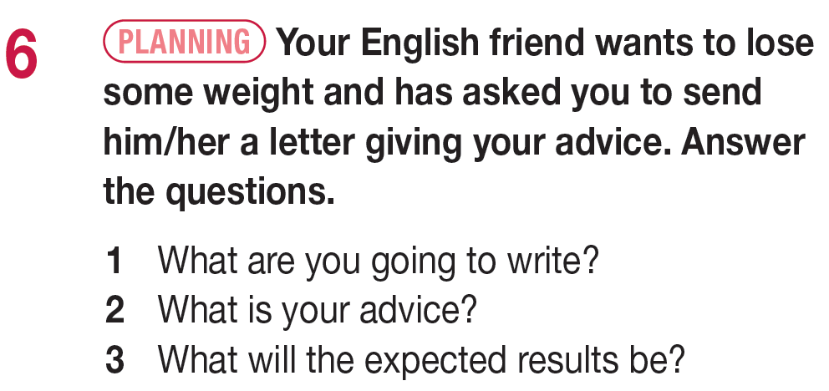
1 I’m going to write a letter giving advice.
2 Try not to eat late at night. Make some new low-calorie recipes.
3 You won’t add extra calories before sleeping.
You won’t get bored with your diet.

Slide 19
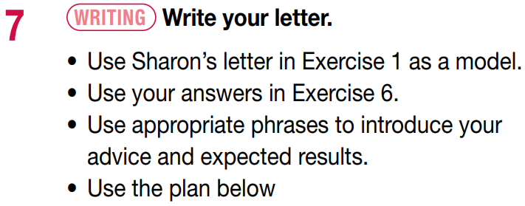
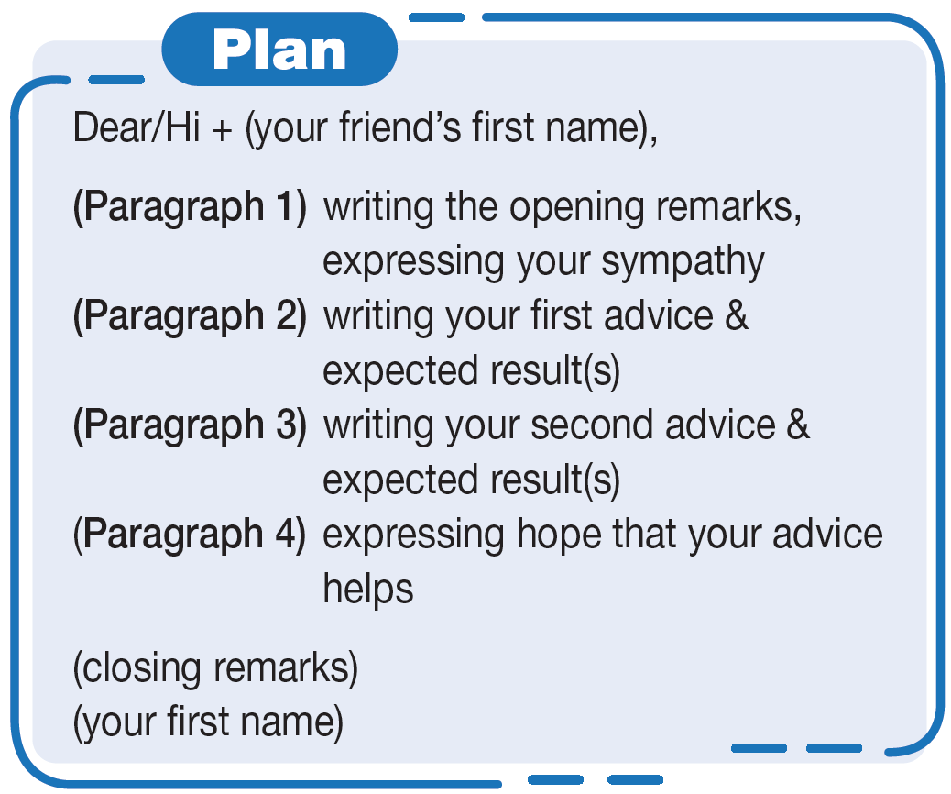

Slide 20

Post - Writing

Slide 21
Peer check
Work in pairs. Swap your essay with your partner and check each other’s work.

Slide 22
Suggested answer
Dear Tina,
I received your letter. It was nice hearing from you. I’m sorry to hear that you are having trouble losing weight. It is quite difficult, but I think I can help.
The best thing you can do is try not to eat late at night. In this way, you won’t add extra calories before sleeping. Most people snack late at night and that’s why they gain weight.
Another thing you could do is to make some new low-calorie recipes. You can find plenty of ideas on the Internet. If you do this, you won’t get bored with your diet. While it’s easy to get tired when you eat low-calorie food, having a variety will make up for it.
I am sure it will become a habit for you in the future. I hope I’ve been of some help. Losing weight can be challenging but I know you can do this. Write back soon and tell me your results.
Yours,
Annabelle

Slide 23




Slide 24
A plan of a letter giving advice.
Dear/Hi + (your friend’s first name),
(Para 1) writing the opening remarks, expressing sympathy
(Para 2) writing your first advice & expected results
(Para 3) writing your second advice & expected results
(Para 4) expressing hope that your advice helps
(closing remarks)
(your first name)

Slide 25



Slide 26
Today’s lesson
Reading: general information and specific information
Writing: a letter to give advice

Slide 27
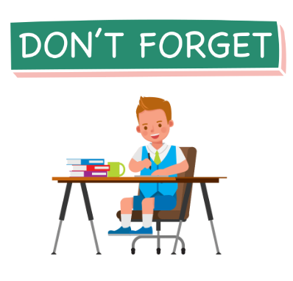

Review letter structure.
Do the exercises in WB: Unit 7e – Exercises 1 – 2 – 3 – 4 – 5 (page 61).
Prepare: Unit 8 - Lesson 1 (page 85 – SB).

Slide 28

Stay positive and have a happy day!
See you in the next lesson.

